Slide 1
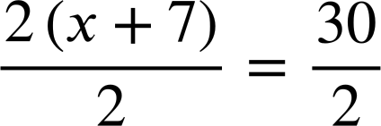
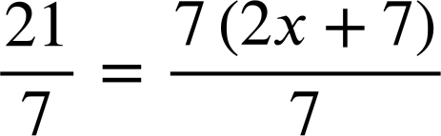
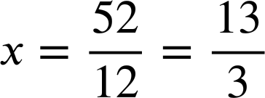





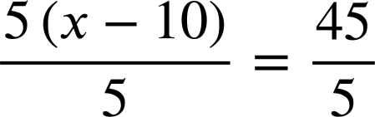

Solving linear equations where brackets are used
Task A: Using reciprocals to solve equations with brackets
1) Solve these equations in two different ways. Firstly, by expanding the bracket as a first step. Secondly, by multiplying by the reciprocal.
a)
2(x + 7) | = | 30
2x + 14 | = | 30
2x | = | 16
x | = | 8
2(x + 7) | = | 30
x + 7 | = | 15
x | = | 8
b)
21 | = | 7(2x + 7)
21 | = | 14x + 49
−28 | = | 14x
x | = | −2
21 | = | 7(2x + 7)
3 | = | 2x + 7
x | = | −2
2) Solve by expanding first:
5(x − 1) | = | 3(3x − 11)
5x − 5 | = | 9x − 33
−5 | = | 4x − 33
28 | = | 4x
x | = | 7
3(x − 1) | = | 5(3x − 11)
3x − 3 | = | 15x − 55
3x + 52 | = | 15x
52 | = | 12x
a)
b)
3) Laura and Izzy have solved an equation by removing the brackets.
5(x − 10) | = | 45
5x − 10 | = | 45
5x | = | 55
x | = | 11
5(x − 10) | = | 45
x − 10 | = | 9
x | = | 19
Laura
Izzy
Only one pupil is correct.
Write a sentence explaining why the right method worked and write a sentence explaining what went wrong in the other one.
Izzy is correct. She has multiplied both sides by the reciprocal
leaves the simple equation
Laura is incorrect. She has simply erased the brackets rather than multiplied them out; you have to make sure both terms inside the bracket are multiplied. 5(x − 10) should multiply out to 5x − 50

Slide 2
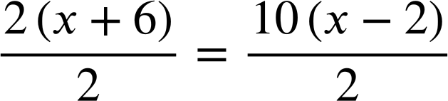
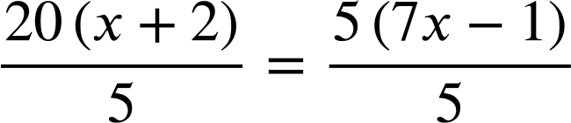







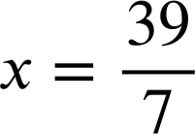



Solving linear equations where brackets are used
Task B: Efficient methods to solve equations
1) Solve this equation using both methods and write a sentence comparing the efficiency of the methods.
Expanding first:
Multiplying by the reciprocal first:
5(x + 13) | = | 40
5x + 65 | = | 40
5x | = | −25
x | = | −5
You may have written, “For this equation multiplying by the reciprocal was the most efficient method. In one step it gave us a simple equation to solve.”
5(x + 13) | = | 40
x + 13 | = | 8
x | = | −5
2) Solve both of these equations twice using two different methods.
a)
2(x + 6) | = | 10(x − 2)
2x + 12 | = | 10x − 20
12 | = | 8x − 20
32 | = | 8x
x | = | 4
20(x + 2) | = | 5(7x − 1)
20x + 40 | = | 35x − 5
40 | = | 15x − 5
45 | = | 15x
x | = | 3
2(x + 6) | = | 10(x − 2)
20(x + 2) | = | 5(7x − 1)
x + 6 | = | 5(x − 2)
x + 6 | = | 5x − 10
16 | = | 4x
x | = | 4
4(x + 2) | = | 7x − 1
4x + 8 | = | 7x − 1
9 | = | 3x
x | = | 3
3) Solve:
a)
b)
or…
7x − 4 | = | 35
7x | = | 39
2(5x − 15) | = | 15(x +4)
10x − 30 | = | 15x + 60
−90 | = | 5x
x | = | −18
Mathematics in Education and Industry.
v2.3

